Slide 1

Bank Management Systeme
Submitted By
Hajira Imran(44594)
To:Miss Kausar

Slide 2

What’s in it for you?
Introduction
Overview
Objective
Key Features
Tools & Technologies
Shell Scripting
Environment File Handling
Specific Linux Commands
Results
Achievements & Performance
Conclusion
Future Feature enhancements
Key Takeaways from the Project

Slide 3

Introduction

Slide 4

Overview
A shell scripting-based application designed to automate and streamline basic banking operations.
Built on the Linux environment, leveraging shell scripting capabilities.
Simulates key functionalities such as account management, transaction handling, and data storage.
Provides a menu-driven interface for user-friendly interaction.
Demonstrates the practical power of shell scripting in solving real-world problems efficiently.

Slide 5

Objectives
Automate routine banking tasks like account creation, balance inquiries, and transaction handling.
Gain practical experience in shell scripting, file handling, and Linux commands
Showcase how shell scripting can serve as an efficient tool for managing small-scale systems without the need for complex software.
Emphasize modular and reusable code for seamless operations.

Slide 6

Key Features
Account Management
Transaction Handling
Data Storage
User Interface
Reports Generation
Error Handling

Slide 7
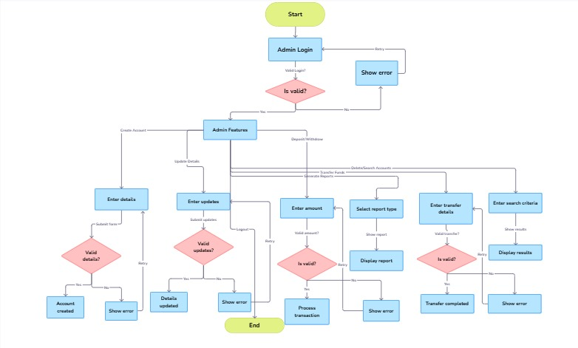
Admin

Slide 8
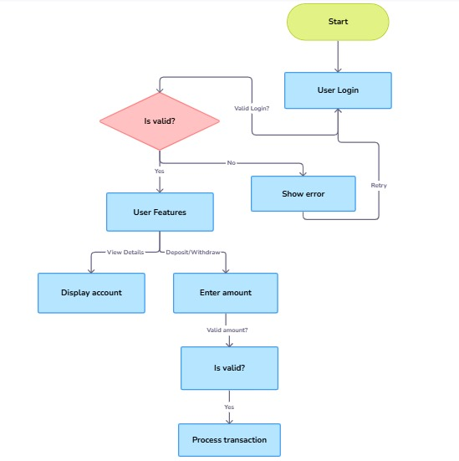
User

Slide 9
Tools & Technologies

Slide 10

Shell Scripting
Developed using Bash Shell, a widely-used scripting language for Linux.
Utilizes scripting constructs like loops, conditional statements, and functions for modular code.

Slide 11

Environment
Executed in a Linux operating system for its robust command-line interface and file-handling capabilities.
Compatible with various Linux distributions, ensuring portability.

Slide 12

File Handling
All account data is stored in plain text files for simplicity and accessibility
Operations included:
Reading files: To retrieve account details.
Writing to files: To update balances or add new accounts.
Appending files: To log transactions or reports.
Error handling: To manage file locks or invalid file access

Slide 13

Specific Linux Commands and Utilities used
echo and read: For displaying and capturing user input.
cat, grep: For reading, searching, and modifying account data.
sort and uniq: For organizing account lists and removing duplicates.
chmod: To manage file permissions and secure sensitive data.
sed,ps,kill,top
cut

Slide 14
Results

Slide 15
Achievements | Performance
Successfully implemented a functional Bank Management System using shell scripting. | The script is fast and lightweight, executing operations in real-time with minimal resource usage.
Automated key banking operations such as account creation, transaction handling, and report generation. | The use of efficient Linux commands results in quick data processing even with large account records
Provided a user-friendly menu-driven interface for seamless interaction. | Demonstrates high portability, working across different Linux environments.
Enhanced understanding of Linux commands, error handling, and modular programming with shell scripting. | Handles concurrent operations smoothly using file locks to avoid data conflicts.
Showcased the capability of shell scripting to solve real-world problems without requiring complex software or external libraries.

Slide 16
Conclusion

Slide 17

Future Feature enhancements
Integration with Database
Real-Time Transaction Monitoring
Financial Reporting and Analytics
Chatbot for Customer Support
API Integration

Slide 18

Key Takeaways from the Project
Learned the practical application of shell scripting to solve real-world problems.
Gained expertise in file handling, Linux commands, and scripting logic
Showcased how shell scripting can create functional systems for small-scale operations

Slide 19
ANY QUESTIONS?

Slide 20
Thank You

